Slide 1

CIS355A Final Project Presentation – Java for Business
John Francis
CIS355A

Slide 2
Introduction
Java is one of the top programming languages in the world.
Java provides exceptional GUI features.
Java is able to read and write to files.
Java provides a simple connection to database.

Slide 3

Module 1:Design Phase
Design is critical to save time.
The client can view the design documents.
Wireframe diagram gives us a target to achieve.
ULM Class diagram provides structure for out application.

Slide 4
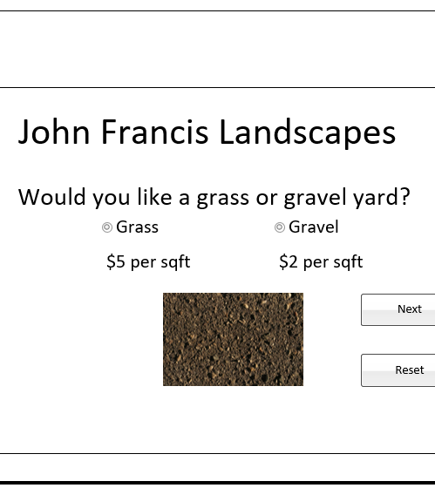
Wireframe Diagram
Gui design
Components to be used
Layout for the screens

Slide 5
UML Class Diagram
Designing classes to be used
Structure for our objects
Overall structure for application

Slide 6
Simple GUI Aplication
We started with a simple GUI application
Implemented labels, textfields
Generated the frame
Centered the application

Slide 7
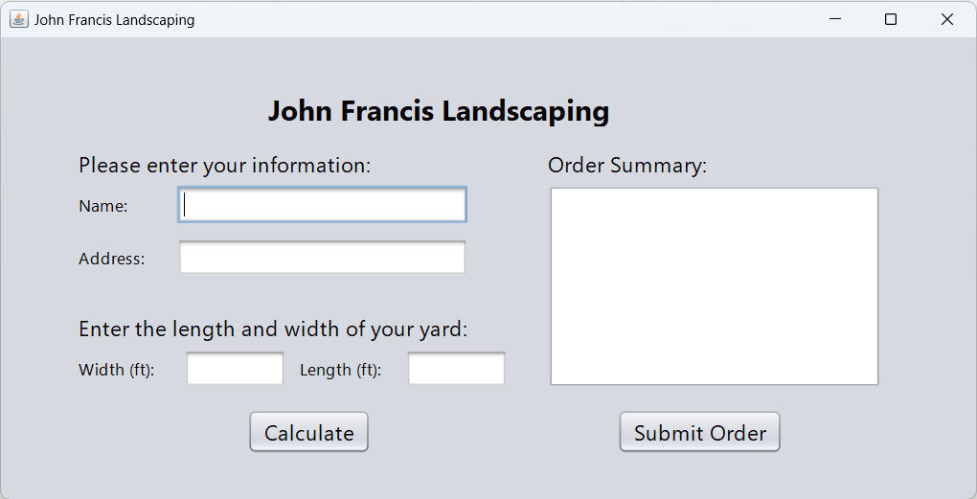
Module 2: Simple GUI
Labels – show info to user
Textfields – get info
Buttons – produce events
Event handlers – run code based on the event

Slide 8
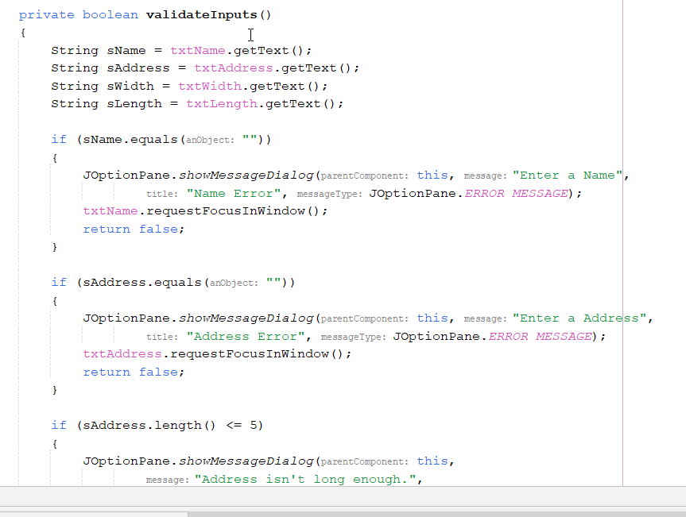
Event Code
Code divided into methods
Write once, Use everywhere!
Imput Validation Method
Pull Input from textfields
Checks to ensure values are not empty
Returns focus to required field

Slide 9
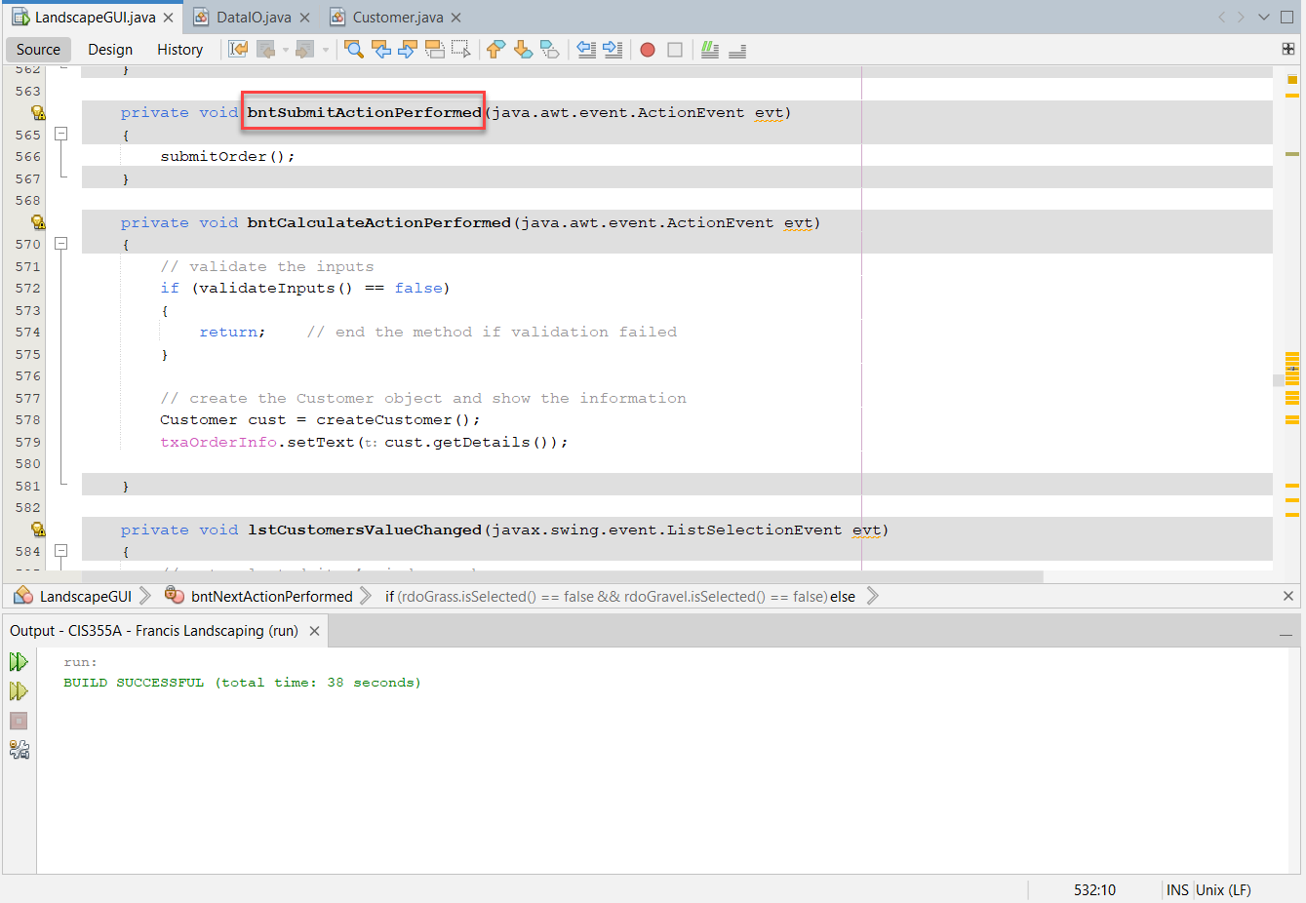
Module 3: advanced gui
Learned Advanced controls for GUI
Created the GUI Launcher and class
Added Action Listener, Radio Buttons, Checkboxes and Panel.
Updated Event Handlers
Showed the JFrame

Slide 10
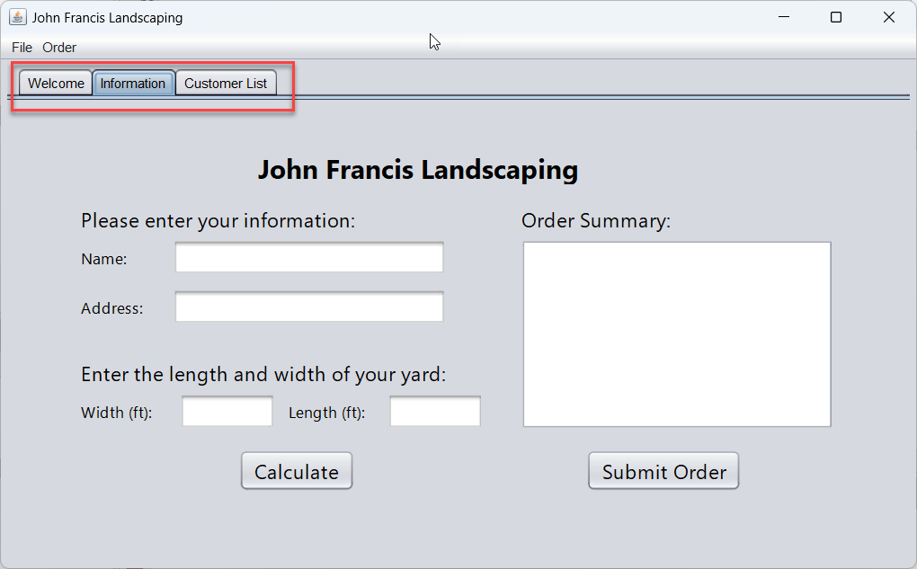
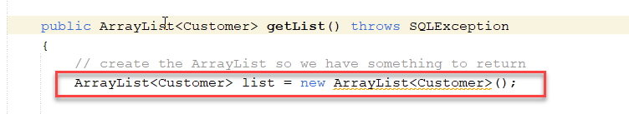
Module 4: Processing Arrays of Objects
Processed Arrays of Objects and List Objects.
Updated Jlist Components
Added and Removed Values from a list
Tabbed Panes

Slide 11
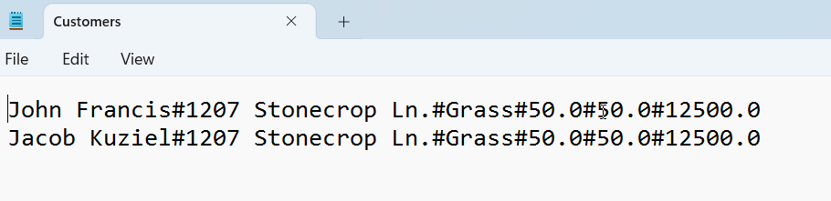
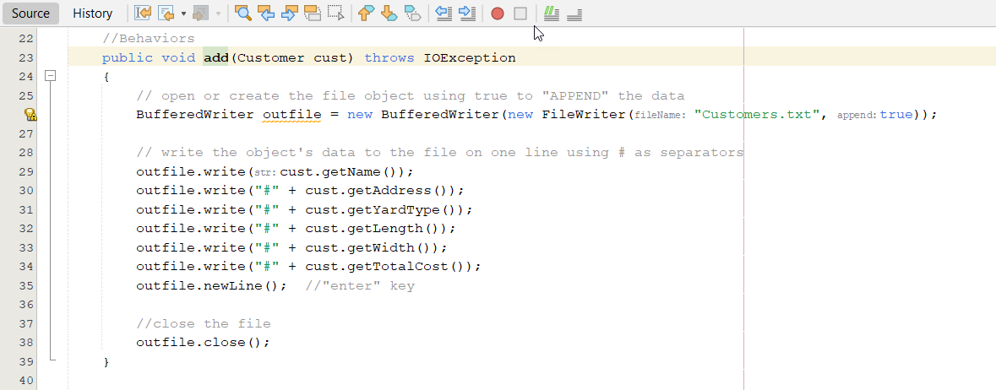
Module 5: File Processing
File Processing
Working with the File
Processing in Java
Reading and Writing to the Application

Slide 12
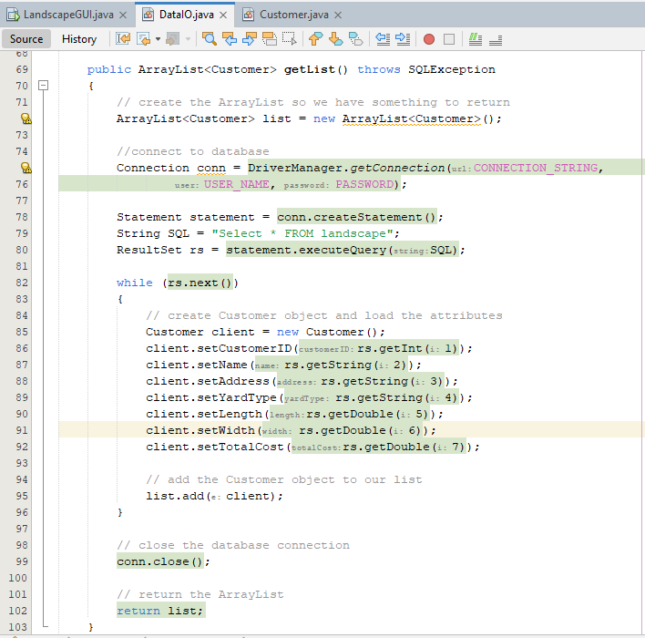
Module 6: Database Connectivity
Created Database connections
Learned SQL
Processed SQL
Read and Write to Tables

Slide 13
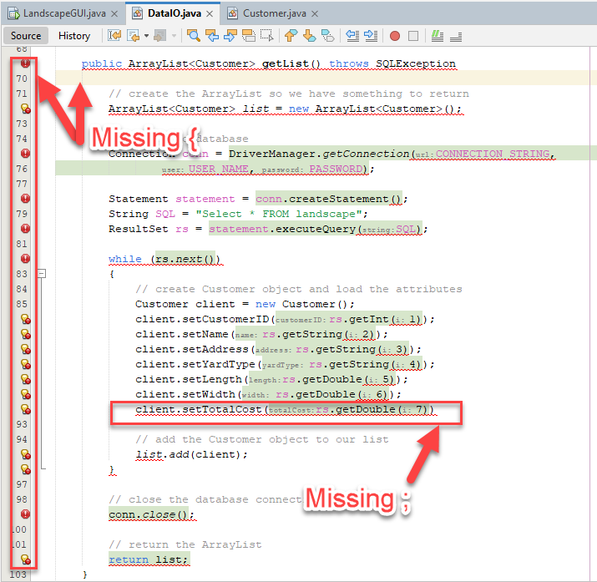
Challenges
Code is case sensitive
Some errors required debugging skills
Alignment issues require trial and error
Always check { and ; in statements

Slide 14
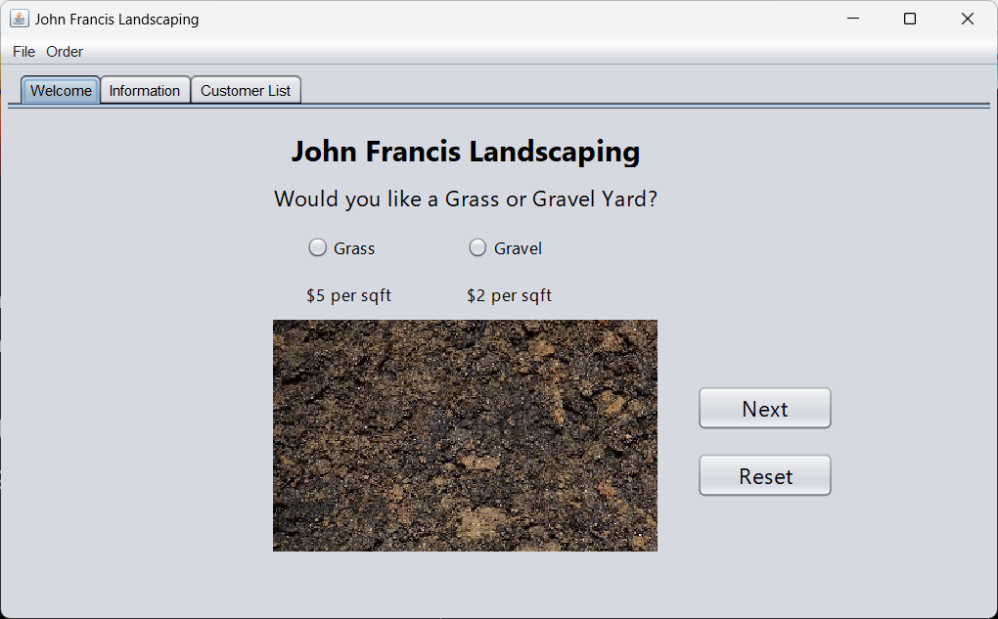
Career Skills
Designing GUI’s in Java
Designing classes using UML
Using three-tier development
Using Java syntax
Debugging applications

Slide 15
conclusion
Java software development is exciting!
Designing GUI applications can be straight forward.
Reading and writing to files is important.
Reading and writing to databases is critical.

